Slide 1
Diskrit
Galih Anggoro Prasetya 22205018 Teknik Informatika
+
3-1

Slide 2
+
Tugas Aljabar Boolean

Slide 3
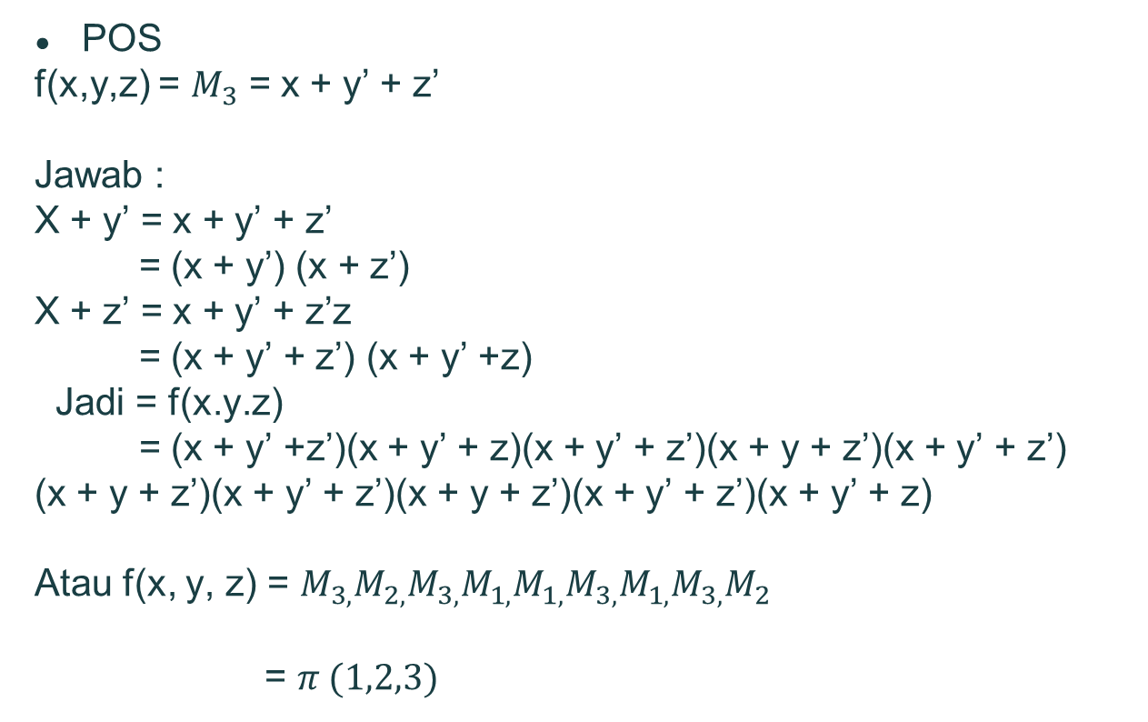
POS
f(x,y,z) = $M_{3}$ = x + y’ + z’
Jawab :
X + y’ = x + y’ + z’
= (x + y’) (x + z’)
X + z’ = x + y’ + z’z
= (x + y’ + z’) (x + y’ +z)
Jadi = f(x.y.z)
= (x + y’ +z’)(x + y’ + z)(x + y’ + z’)(x + y + z’)(x + y’ + z’)
(x + y + z’)(x + y’ + z’)(x + y + z’)(x + y’ + z’)(x + y’ + z)
Atau f(x, y, z) = $M_{3,}M_{2,}M_{3,}M_{1,}M_{1,}M_{3,}M_{1,}M_{3,}M_{2}$
= $π (1,2,3)$

Slide 4
+
Selesai

